Slide 1
Tutorial 1 Group C10
27th August 2018
Joanne Ong

Slide 2
Introduction
Joanne Ong
Year 3 CS student
Took CS1101S in AY16/17 Sem 1
Notes:
5 mins

Slide 3
Your turn!
Name
Course
Any programming experience?
Notes:
Take attendance at the same time!

Slide 4
Plans for today
Recap: finding the maximum (flowchart)
Problem Set 1
Accessing pe111 to pe120
Basic UNIX commands

Slide 5
Recap: finding the maximum
Input: a finite list L of k integers (k > 0)
Output: integer with max value from the list
1 -4 0 9
Notes:
What is the correct output in this example?
(10 mins)

Slide 6
Recap: finding the maximum
Input: a finite list L of k integers (k > 0)
Output: integer with max value from the list
1 -4 0 9
Notes:
Yeap, it’s 9.

Slide 7
Recap: finding the maximum
1 -4 0 9
Strategy: “check one-by-one”, and keep track of the maximum
Notes:
So how do we solve this problem?
Recall that the main strategy is to “check one-by-one” and keep track of the maximum.

Slide 8
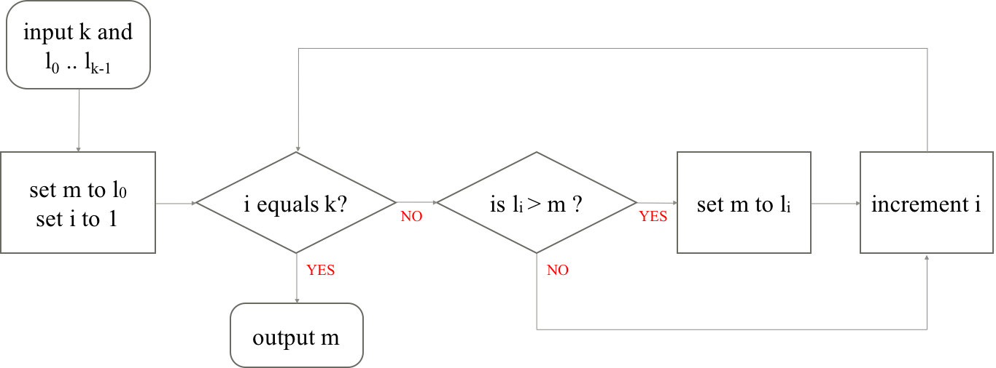
Recap: finding the maximum
k: no. of elements in list
i: index of element being checked
l_{i}: element being checked
m: max so far
1 -4 0 9
i | l_{i} | k | max so far (m)
Notes:
This strategy/ algorithm can be represented by a flowchart. Let’s quickly recap how to trace through the flowchart.

Slide 9
Recap: finding the maximum
k: no. of elements in list
i: index of element being checked
l_{i}: element being checked
m: max so far
1 -4 0 9
i | l_{i} | k | max so far (m)
1
-4
4
1
Notes:
Okay, so even though i = 1, li is the second element in the list. This is because we start counting from 0 for elements in the list, so the list has elements l0 … l(k-1).

Slide 10
Recap: finding the maximum
k: no. of elements in list
i: index of element being checked
l_{i}: element being checked
m: max so far
1 -4 0 9
i | l_{i} | k | max so far (m)
1
-4
4
1
2
0
4
1

Slide 11
Recap: finding the maximum
k: no. of elements in list
i: index of element being checked
l_{i}: element being checked
m: max so far
1 -4 0 9
i | l_{i} | k | max so far (m)
1
-4
4
1
2
0
4
1
3
9
4
9

Slide 12
Recap: finding the maximum
k: no. of elements in list
i: index of element being checked
l_{i}: element being checked
m: max so far
1 -4 0 9
i | l_{i} | k | max so far (m)
1
-4
4
1
2
0
4
1
3
9
4
9
4
4
9

Slide 13
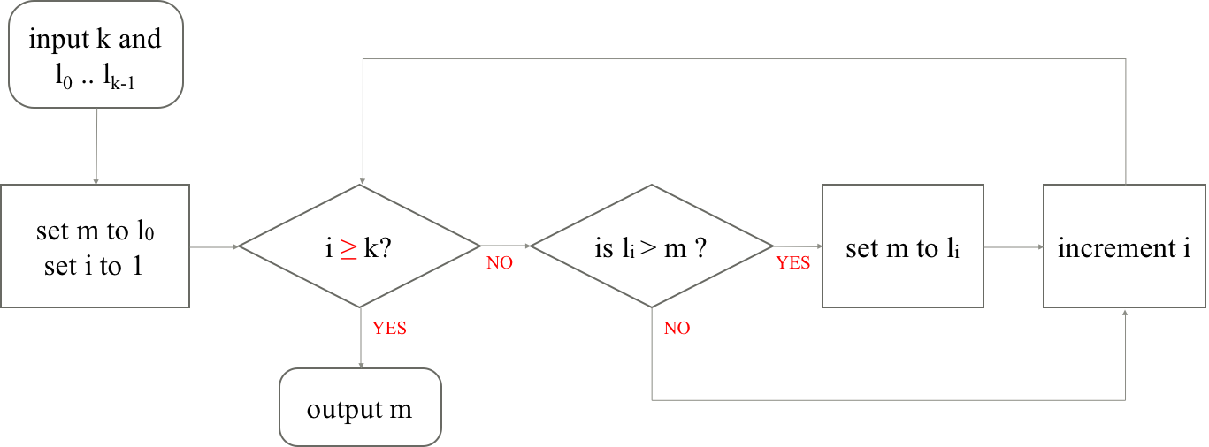
Problem 1.1 (a)
Notes:
Let’s go through a few problems from the first problem set. (30 mins)
Here, the check for “i equals k?” has been changed to “i more than or equals k?”.
Does this affect the correctness of the algorithm? (Who thinks it’s still correct?)
Why is the algorithm still correct?

Slide 14
Problem 1.1 (a)
Correctness is not affected.
Since i starts from 1, and increases by 1 every time until i equals k is true, i will never be larger than k

Slide 15
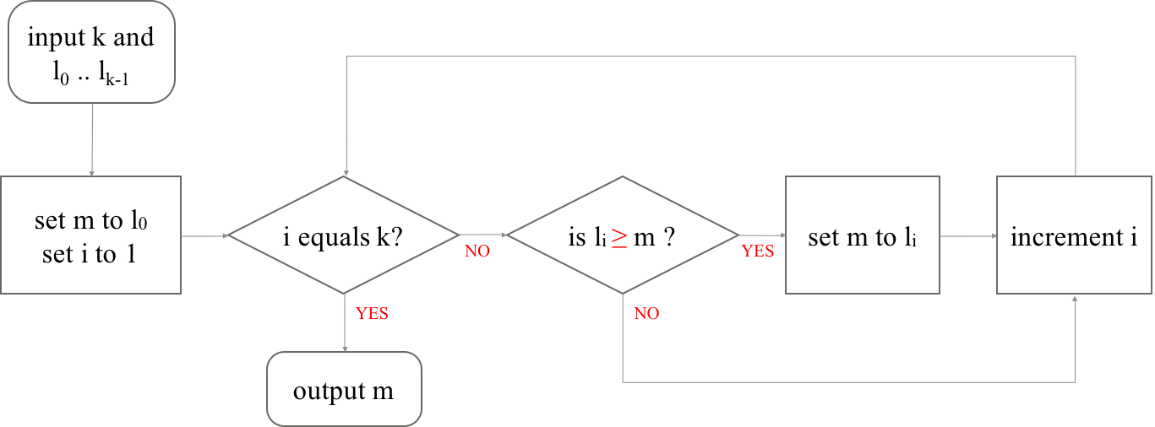
Problem 1.1 (b)
Notes:
Here, the check for “li more than m?” has been changed to “li more than or equals m?”.
Does this affect the correctness of the algorithm? (Who thinks it’s still correct?)
Why is the algorithm still correct?

Slide 16
Problem 1.1 (b)
Correctness is not affected.
m is only set if li is at least as large as the current maximum.

Slide 17
Problem 1.1 (b)
Challenge: Even though the output is correct, how does the behaviour of the algorithm change?
Notes:
Hint: what if the maximum occurs multiple times?
Answer: The algorithm in part(b) here will return the last occurrence.

Slide 18
Problem 1.1 (b)
CS1010 Midterms
Student ID (lowest to highest) | Marks obtained
1010 | 99
1231 | 47
2100 | 99
2106 | 89
Notes:
Let’s look at an example.
Let’s say we have a list of students, with their student ids in increasing order and their marks.

Slide 19
Problem 1.1 (b)
CS1010 Midterms
Student ID (lowest to highest) | Marks obtained
1010 | 99
1231 | 47
2100 | 99
2106 | 89
original
(b)
Notes:
If two students have the same maximum score, the original algorithm will return the student with the lowest student id.
But the algorithm in (b) will return the student with the highest student id.

Slide 20
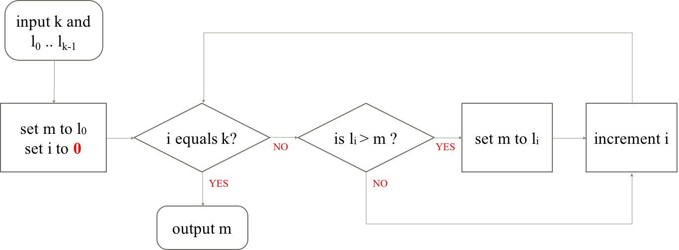
Problem 1.1 (c)
Notes:
Here, we start by setting i to 0 instead of i to 1.
Does this affect the correctness of the algorithm? (Who thinks it’s still correct?)
Why is the algorithm still correct?

Slide 21
Problem 1.1 (c)
Correctness is not affected.
This just means we will scan l₀ again. But then l₀ > m will be false, so m will not be updated and i will be increased to 1.

Slide 22
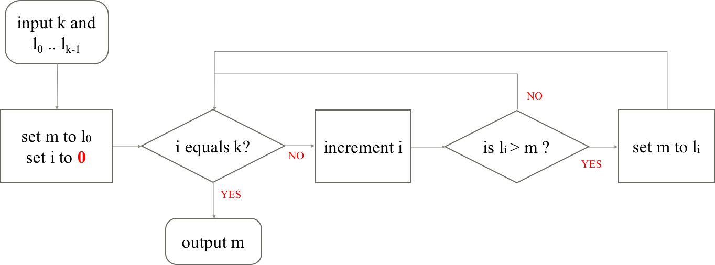
Problem 1.1 (d)

Slide 23
Problem 1.1 (d)
1 -4 0 9
i | k
0 | 4
1 | 4
2 | 4
3 | 4
i | l_{i}
1 | -4
2 | 0
3 | 9
4 | ???
Notes:
The algorithm is buggy in this case!
When we reach the last element, i equals k – 1. The condition “i equals k” is still false, so we increment i to k. We will then try to compare l k to m, but l k is undefined!!
How can we fix this bug?

Slide 24
Problem 1.1 (d)
1 -4 0 9
i equals k-1?
i | k
0 | 4
1 | 4
2 | 4
i | l_{i}
1 | -4
2 | 0
3 | 9
Notes:
Change ”i equals k?” to “i equals k-1?”!

Slide 25
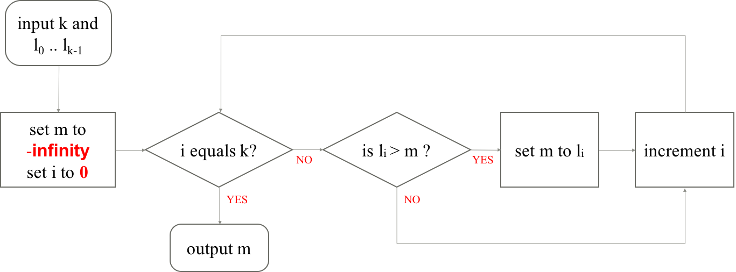
Problem 1.1 (e)
Notes:
Here, we start by setting i to 0 instead of i to 1, and m to –infinity.
Does this affect the correctness of the algorithm? (Who thinks it’s still correct?)
Why is the algorithm still correct?

Slide 26
Problem 1.1 (e)
Correctness is not affected.
When we initialize m to –infinity, it is guaranteed to be no larger than any other elements.

Slide 27
Problem 1.1 (e)
This version will work for a list with no elements!
Previous versions need at least 1 element in the list (m is set to l₀ at first).

Slide 28
Problem 1.2
Change the algorithm to find the minimum value instead of the maximum value from the given list L={l₀,...,l_{k-1}}.
You can also assume that the list L is finite and k>0 for this question.
Notes:
5 minutes

Slide 29
Problem 1.2
Is li < m?
Keep track of the minimum so far instead of the maximum.

Slide 30
Problem 1.3
Draw the flowchart for an algorithm, that takes in a list of integers L={l₀,...,l_{k-1}}, k≥0 and compute the sum of all the integers.
Think about what variable(s) do you need.
Notes:
5 minutes

Slide 31
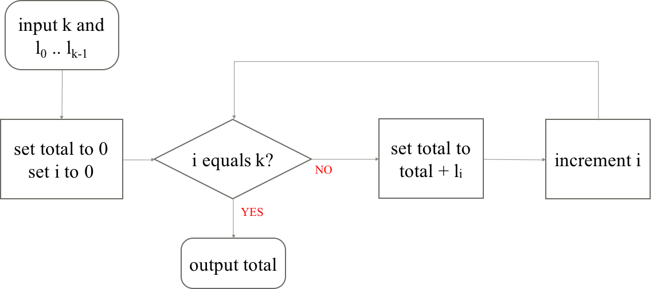
Problem 1.3
Need a variable to keep track of the current total

Slide 32
Accessing pe111 to pe120
1. Use XShell on lab PC
2. Login to <username>@pe111.comp.nus.edu.sg
- username is your SoC Unix account (you can check https://mysoc.nus.edu.sg/~myacct/)
- if you don’t have an account/ need to reset password: https://mysoc.nus.edu.sg/~newacct/
- if you have an account but cannot login, trying logging in to <username>@sunfire.comp.nus.edu.sg
- Make sure you enabled access to SoC Compute Cluster at https://mysoc.nus.edu.sg/~myacct/services.cgi
Notes:
5 minutes

Slide 33
Note: cannot directly access outside SoC!
Cannot access pe111 to pe120 directly outside of SoC
Either use a VPN
Or tunnel via sunfire
Check the cs1010 website for more details!

Slide 34
Unix command line
- Can be used to create directories, manipulate files and running certain applications
Is flexible and customisable
Can automate commands for repetitive tasks
Is faster than using a Graphical User Interface (GUI)
Notes:
Unix walkthrough (30 mins)
Now that everyone has managed to log in, what you are using is called a Unix command line. You can use this command line to do many things, like creating directories, manipulating files, and running certain applications. Why do we want to use the command line? There are a few reasons.

Slide 35
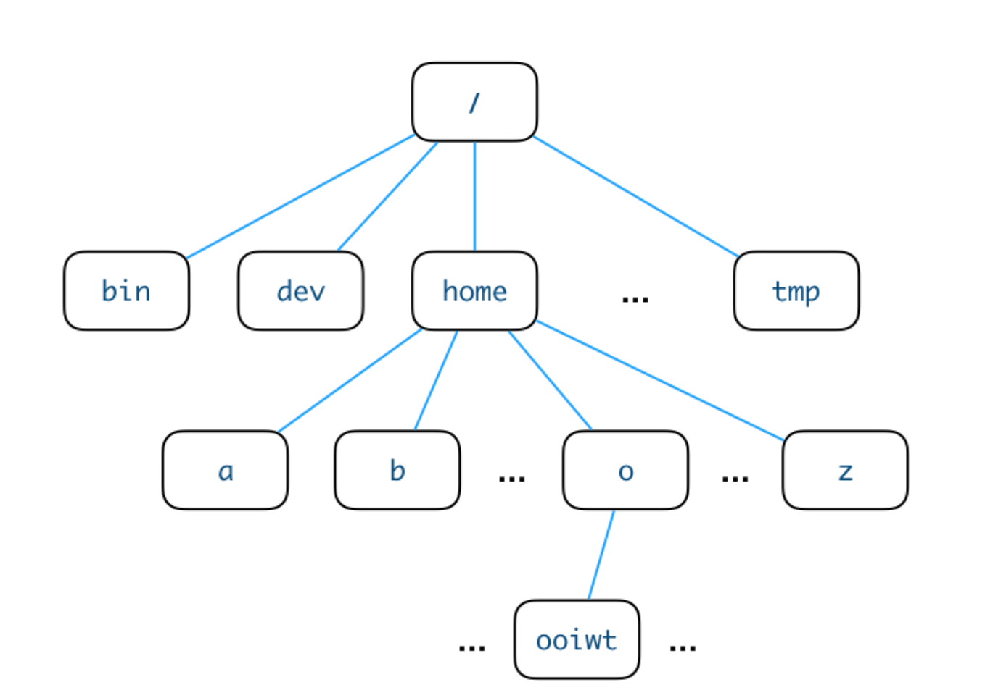
Directory structure in Unix
~ indicates you are in your home directory
automatically here after you log in
you can create files in your home directory, but not elsewhere unless permission is given

Slide 36
man
man <command>: checks command (manual)
E.g. ’man man’ checks how to use man!
Use this for the next few commands!

Slide 37
pwd
pwd: print working directory
shows which directory you are currently in
/ deliminates different parts of the directory structure (like URLs!)
Notes:
What do you think “pwd” stands for? You can use ‘man pwd’ to find out.
What does it do? What is a working directory.

Slide 38
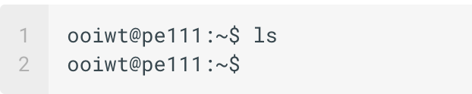
ls
ls: list
list files in current working directory
rule of silence: if there are no files, nothing will be printed!

Slide 39
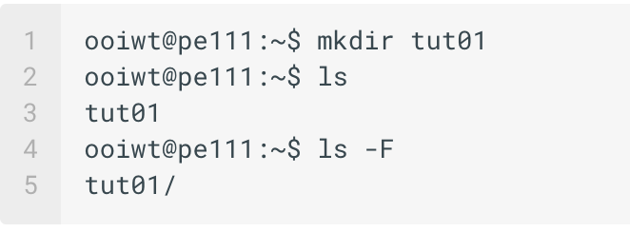
mkdir
mkdir: make a subdirectory
creates a subdirectory with given name in the current directory
you can use ’ls’ to check your directory

Slide 40
mkdir
ls –F : provides more information
/ in ‘tut01/’ tells you that the file is a directory
ls –l : shows almost all file information

Slide 41
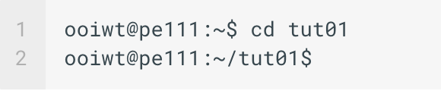
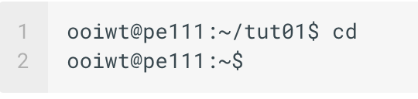
cd
cd: change current working directory
typing “cd” alone brings you back to your HOME directory!

Slide 42
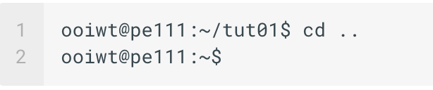
cd
.. (two dots) refer to the parent directory
can also use this to return to HOME directory for this case

Slide 43
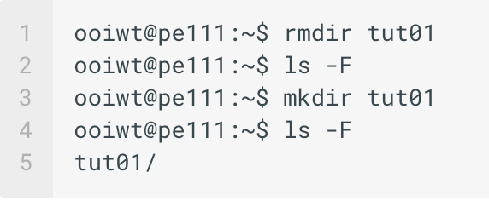
rmdir
rmdir: remove a subdirectory
Directory must be empty before it can be removed!
Notes:
How to remove directory if it is not empty? We will cover that later, in a few more minutes.

Slide 44
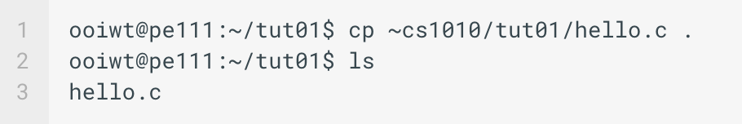
cp
cp: copy files
here, the file ‘hello.c’ is copied from the HOME of user cs1010, under directory tut01 to the current directory

Slide 45
cp
cp –r: copy the whole directory (recursive copy)
. (single dot) refers to current directory
everything in ‘tut01’ will be copied to current working directory

Slide 46
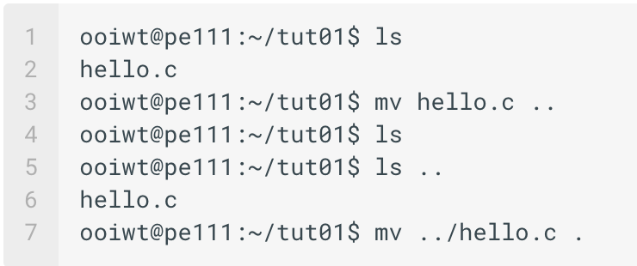
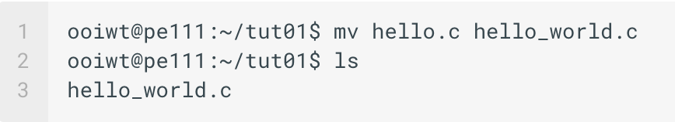
mv
move files
rename files
mv: move or rename files
note: if you have a very long file name, use `TAB` for autocompletion!

Slide 47
rm
rm: remove files
rm –rf *: delete all files (recursively delete), no questions asked (forceful delete)
rm –i: interactively ask if you are sure you want to delete a file
everyone’s accounts have been configured so `rm` will become `rm –i`

Slide 48
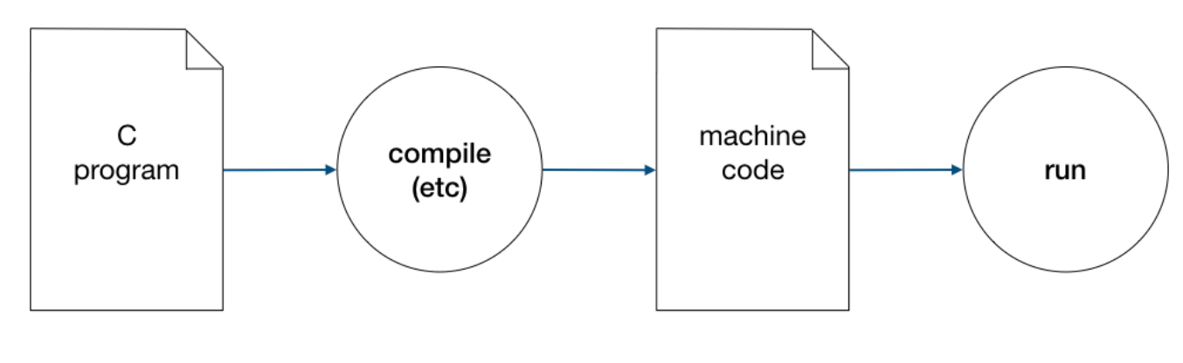
Compile and run a C program
go to the directory containing ’hello.c’
type ‘clang hello.c’
run executable with ‘./a.out’
Notes:
5 minutes (can skip if out of time)

Slide 49
Renaming executable file
a.out: stands for assembler output
can rename this by using: ‘clang hello.c –o hello’ or ‘clang -o hello hello.c’
DO NOT do ‘clang –o hello.c hello’ → this will overwrite your code in ‘hello.c’!

Slide 50

SHORT QUIZ! (unix commands)

Slide 51
Q1: How do you check how to use a command?
Ans: man <command>

Slide 52
Q2: How do you use the auto-completion feature?
Ans: Type the first letter, then press `TAB`

Slide 53
Q3: How do you delete a non-empty directory?
Ans: rm -rf

Slide 54
Q4: Does a . (single dot) represent the parent working directory or the current working directory?
Ans: current working directory

Slide 55
Q5: How do you get a previous command without retyping it?
Ans: up arrow

Slide 56
End.

Slide 57
Reference slides

Slide 58
input k and l₀ .. l_{k-1}
set m to l0
set i to 1
i equals k?
is li > m ?
set m to li
increment i
NO
YES
YES
NO
output m

Slide 59
Problem 1.1 (a)
input k and l₀ .. l_{k-1}
set m to l0
set i to 1
i ≥ k?
is li > m ?
set m to li
increment i
NO
YES
YES
NO
output m

Slide 60
Problem 1.1 (b)
input k and l₀ .. l_{k-1}
set m to l0
set i to 1
i equals k?
is li ≥ m ?
set m to li
increment i
NO
YES
YES
NO
output m

Slide 61
Problem 1.1 (c)
input k and l₀ .. l_{k-1}
set m to l0
set i to 0
i equals k?
is li > m ?
set m to li
increment i
NO
YES
YES
NO
output m

Slide 62
Problem 1.1 (d)
input k and l₀ .. l_{k-1}
NO
set m to l0
set i to 0
i equals k?
increment i
is li > m ?
set m to li
NO
YES
YES
output m

Slide 63
Problem 1.1 (e)
input k and l₀ .. l_{k-1}
set m to
-infinity
set i to 0
i equals k?
is li > m ?
set m to li
increment i
NO
YES
YES
NO
output m

Slide 64
Problem 1.2
Change the algorithm above to find the minimum value instead of the maximum value from the given list L= {l₀,...,l_{k−1}}.

Slide 65
Problem 1.2
input k and l₀ .. l_{k-1}
set m to l0
set i to 1
i equals k?
is li < m ?
set m to li
increment i
NO
YES
YES
NO
output m

Slide 66
Problem 1.3
Draw the flowchart for an algorithm, that takes in a list of integers L= {l₀,...,l_{k−1}}, k ≥ 0, and compute the sum of all the integers. Think about what variable(s) do you need.

Slide 67
Problem 1.3
input k and l₀ .. l_{k-1}
set total to 0
set i to 0
i equals k?
set total to total + li
increment i
NO
YES
output total

